Slide 1
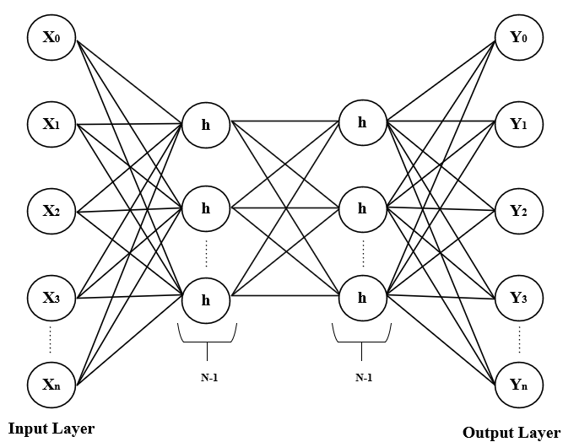
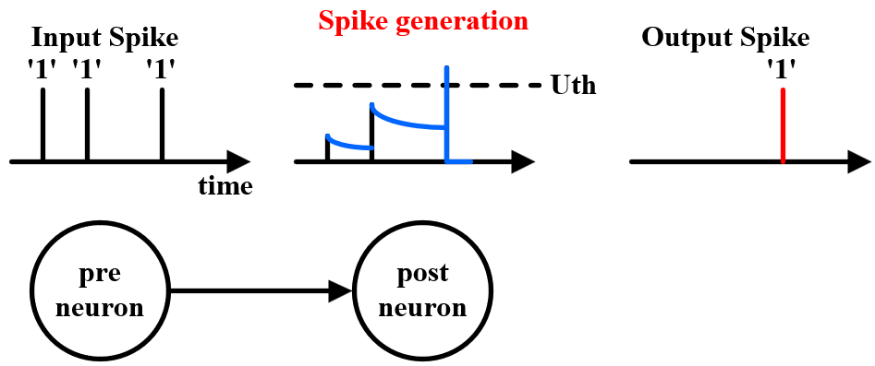
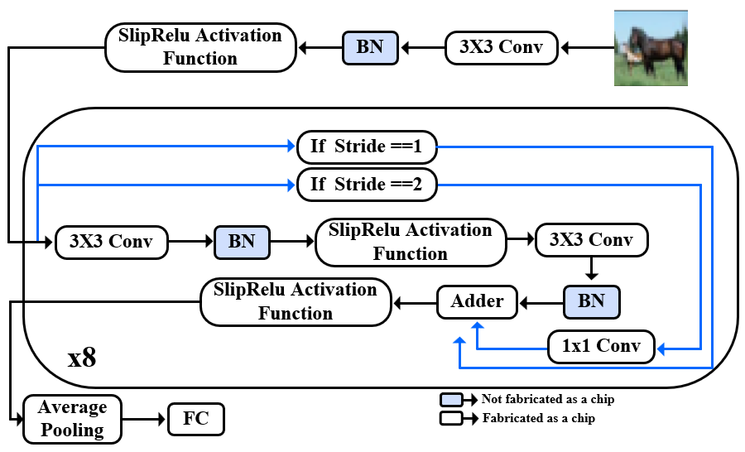
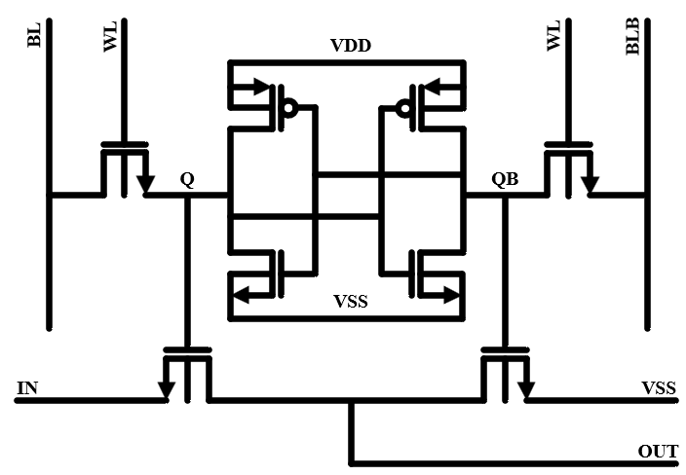
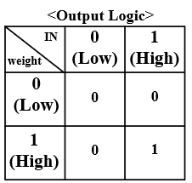
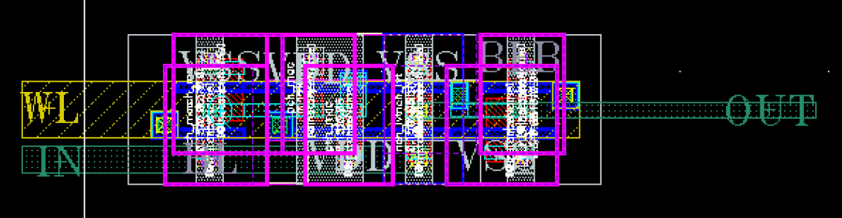
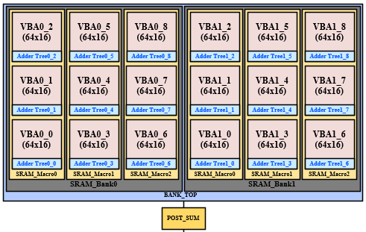
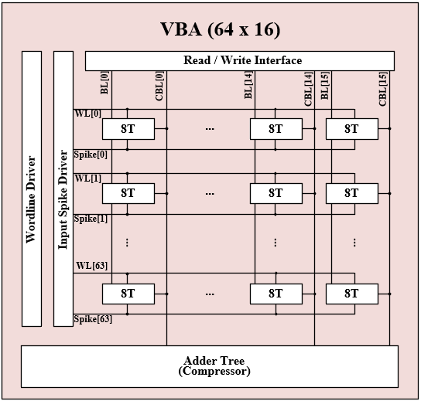
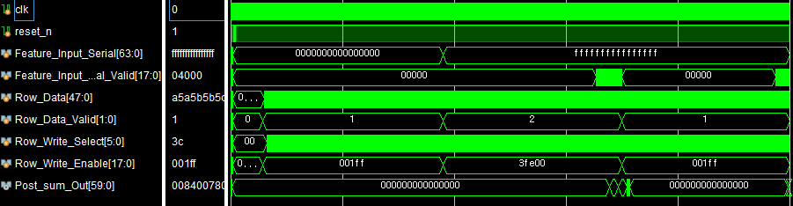
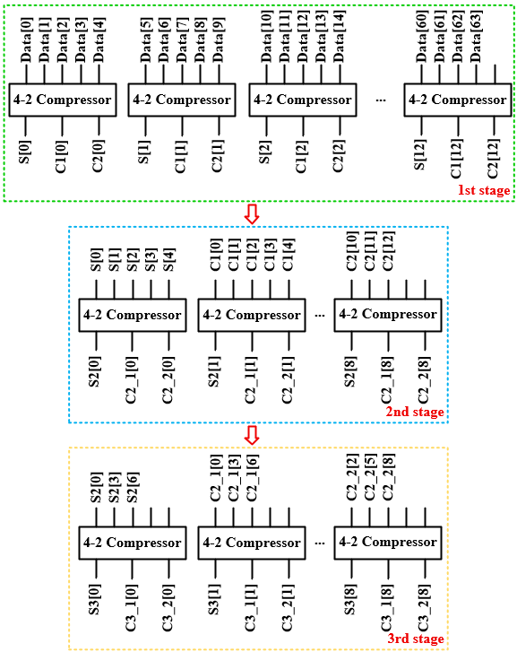
A Neuromorphic Compute-in-Memory Processor for Efficient Acceleration of SlipReLU-Based ANN-to-SNN Converted Spiking ResNet-18
Seol-Hyeon Kim¹ and Min-Seong Chooª
¹School of Electrical Engineering, Hanyang University, Ansan, South Korea
ªSchool of Electrical and Electronic Engineering, Yonsei University, Seoul, Soutth Korea
Abstract: This chip is an SNN-based digital CIM designed in TSMC 28nm, which performs ResNet-18 computations by converting an ANN into an SNN. It executes 3x3 convolution operations by operating SRAM-based arrays in parallel.
그림
그림
Motivation
Proposed SlipReLU-Based ANN-to-SNN model
ANNs : High computational complexity -> Unsuitable for edge devices
SNNs : Energy-efficient, but training remains challenging.
Prior ANN–SNN conversion methods trade accuracy for multi-timestep operation.
The input image is transformed into spike features through the first convolution layer.
그림
그림
Cell Schematic
Cell Layout
8T SRAM Cell Layout
Proposed 8T SRAM Cell Schematic
It performs AND logic.
그림
그림
Main Digital Block
Timing Diagram
SRAM-based Multi Bank Structure
Performs parallel convolution using nine 64x16 SRAM arrays.
Completes full accumulation within 9 clock cycle
Timing Diagram of the Bank_Top + Postsum
Parallel bank operation controlled by ‘Valid’ and ‘Enable’ signal
Post_sum_Out is the modified result of accumulating the Bank-calculated values in the post sum.
그림
그림
Proposed Digital CIM Array Operation
Compressor-Based Adder Tree
Structure Overview
Left figure : Single adder tree in the SRAM Array
16 compressor-based adder trees per array (1 per column)
Adder Tree Configuration
3-stage structure based on 4-2 compressors
Stage 1 : 13 / Stage 2 : 9 / Stage 3 : 9 compressors
Stage-by-Stage Operation
Stage1 : per-row AND results -> partial results
Stage2 & 3 : Group sum, carry1, carry2 from the previous stage -> count 1s via compressors -> perform accumulation
Advantages
Simpler configuration than conventional adder trees
Enables faster computation
Single Bank
IDLE -> Write -> Conv -> Write -> Conv -> Write -> Conv-> Write-> Conv-> Finish (총 5.230ns)
Multi Bank(Bank0/Bank1)
IDLE -> Write/x -> Conv/Write -> Write/Conv -> Conv/Write -> x/Conv -> Finish (총 3.355ns)
The calculation processing speed has improved by approximately 35.85%.
Conclusion: This work presents a digital computing-in-memory (CIM) architecture for SNN-based ResNet-18 inference, implemented in TSMC 28 nm technology. The proposed architecture employs AND-based multiplication between weights and inputs, followed by compressor-based accumulation, effectively exploiting the sparsity of SNN spike signals while reducing computational complexity and energy consumption. In particular, by adopting a dual-bank architecture operating in a ping-pong manner, the inference latency is significantly reduced. For four convolution operations, the conventional single-bank architecture requires 5.230 ns, whereas the proposed dual-bank architecture completes the same operations in only 3.345 ns, achieving a 35.85% reduction in latency. This improvement is achieved by concurrently operating two computation banks, thereby enhancing hardware utilization.
Acknowledgement: This work was supported chip fabrication and EDA Tools by the IC Design Education Center (IDEC).

